Slide 1
Sprint 1
Peter Liu, Russell Habib, Tony Cao

Slide 2
Introduction & Objectives
Quantinnel: AI Powered Roadmap generation to guide enterprises to become PQC ready.
Objectives
  Peter: LLM orchestration architecture; persona requirements; chat context contract defined
  Russell: MCP connectivity research & proof of concept; chat session infrastructure
  Tony: Simulator requirements & architecture

Slide 3
Requirements & Gathering Processes
Requirements
  Define the LLM orchestration architecture & prompt strategy
  Write the requirements for each persona the roadmap generator serves (EA, CTO, CISO)
  Build the roadmap generator's core engine & persona prompt chains
  Define what “simulating an integration” means - inputs, outputs, constraints - before building anything
  Build the core simulation engine and a scenario library for regression testing
  Research and prototype MCP connectivity to BlueDolphin & LeanIX
  Generalize the prototype into a reusable connector framework
  Integrate both tools as adapters on the framework
Gathering Process
  One hour team meetings bi-weekly
  One-on-ones
  Whatsapp channel

Slide 4
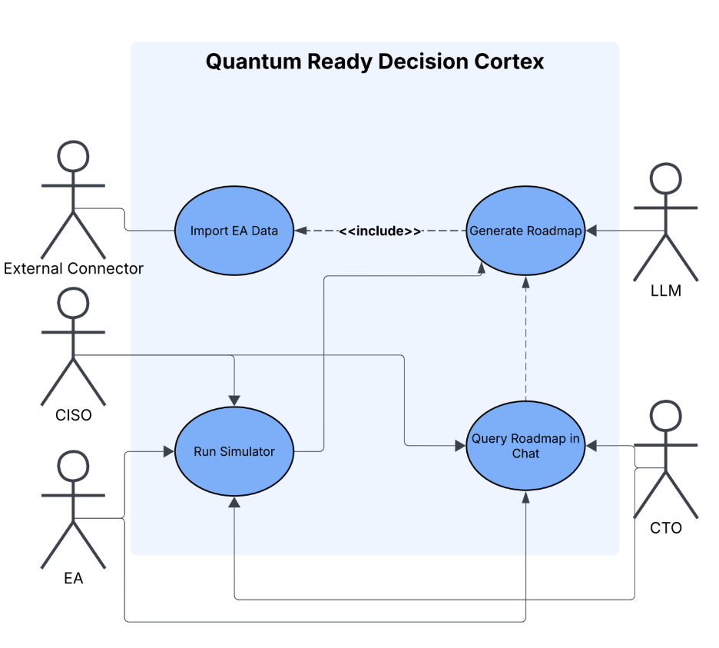
User Stories, Use Cases, and UML

Slide 5
User Stories, Use Cases, and UML (cont.)
As an Enterprise Architect
I want to import our application inventory from BlueDolphin or a CSV file
So that the system can assess our environment without re-entry.
As a CISO
I want to see which applications have quantum vulnerabilities
So that I can address the highest security risks first.
As a CTO
I want a quantum-readiness roadmap written for my role
So that I can present priorities to leadership.
As a CISO,
I want to compare current and proposed quantum-readiness scores,
So that I can understand whether a proposed change improves our security posture.

Slide 6
System Setup
Roadmap generation
  Python, Jev, Claude Sonnet 5-5
Integration simulation
  Python, Quantum Ready scoring engine, Client-provided topology
MCP connectivity
  Python, MCP Python SDK, LeanIX and BlueDolphin APIs, qros topology schema
Chat bot
  Python, FastAPI, PostgreSQL, vanilla HTML/JS frontend, provider-agnostic LLM layer

Slide 7
Features Demo

Slide 8
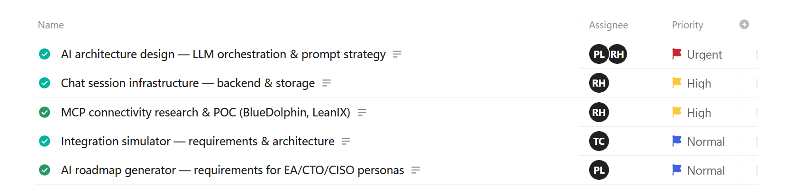
Kanban Overview/Contributions

Slide 9
Skills Identification & Learning Opportunities
Peter
TypeSafe AI's Jev, MCP connectors
Russell
Working with large amounts of data and normalizing it
Tony
Infrastructure topology modeling and dependency analysis
Readiness scoring and assessment workflows

Slide 10
AI Disclosure
Peter
Test case creation, testing Jev capabilities
Russell
Used for some code generation and test cases generation
Used for read me documents as well
Tony
Support for reviewing test cases and debugging approaches
Assistance with understanding simulator architecture and scoring logic

Slide 11
Sprint Achievements & Challenges
Sprint Achievements – Tony
Defined simulator requirements and architecture
Designed simulator integration with the existing Quantum Ready scoring engine.
Challenges – Tony
Understanding the existing scoring rubric and topology structure
Defining integration boundaries across backend components

Slide 12
Sprint Achievements & Challenges (cont.)
Sprint Achievements & Challenges (Peter)
  Working end-to-end pipeline for generating a roadmap based on a persona
  Challenges: Working with new technologies (Jev)
Sprint Achievements & Challenges (Russell)
  Achievements: all sprint items finished and gone beyond sprint objectives into next sprint
  Challenges: not having leanix or bluedolphin api keys to test

Slide 13
Next Steps & Retrospectives
Tony
Refine simulator interfaces and data contracts
Validate the architecture using representative scenarios
Coordinate integration and testing with other backend components
Peter
Roadmap generator core engine & persona prompt chains
role-based output refinement
EAM input handling
Russell
Test mcp with api keys
Integrate llm to chat bot

Slide 14
Thanks!

